Slide 1
Big Mountain Resort Use Case
Executive Presentation

Slide 2
Problem Identification
Big Mountain Ski Resort in Montana has recognized the shortcomings of its current strategy of setting ticket prices at a premium above the market average.
The executives are seeking for guidance on how to select a better value for their ticket price. They are also considering several changes that they hope will either cut costs without undermining the ticket price or will support an even higher ticket price.
Overall, the goal is to identify opportunities with high success rate to increase revenue by $1.54M by evaluating the impact of resort features on pricing.

Slide 3
Problem Identification
Further assessment underlines these key elements that are part of Problem Identification:
Constraints to be considered
The new chair lift adds $1.54 million in annual operating expenses. Any proposed solution must offset or justify this cost increase through improved pricing, higher ticket sales, or operational efficiency.
The resort currently charges a premium above market average, which means its prices are already on the high end. Therefore, raising prices further could reduce demand or alienate cost-sensitive visitors.
Criteria for success
Optimal ticket pricing that is based on data driven analysis and that reflects true value of facilities and services.
Business is able to gain clear insights into which facilities/services that drive the most value so that this analysis guides future investment decisions

Slide 4
Recommendation & Key findings
By implementing Exploratory Data Analysis techniques, it was found that Adult Weekend Ticket Price would be the Target feature to achieve the desired revenue and this feature was positively corelated to the following features in a ski resort:
fastQuads
Runs
total_chairs
resorts_per_100kcapita
Runs
total_chairs
vertical_drop

Slide 5
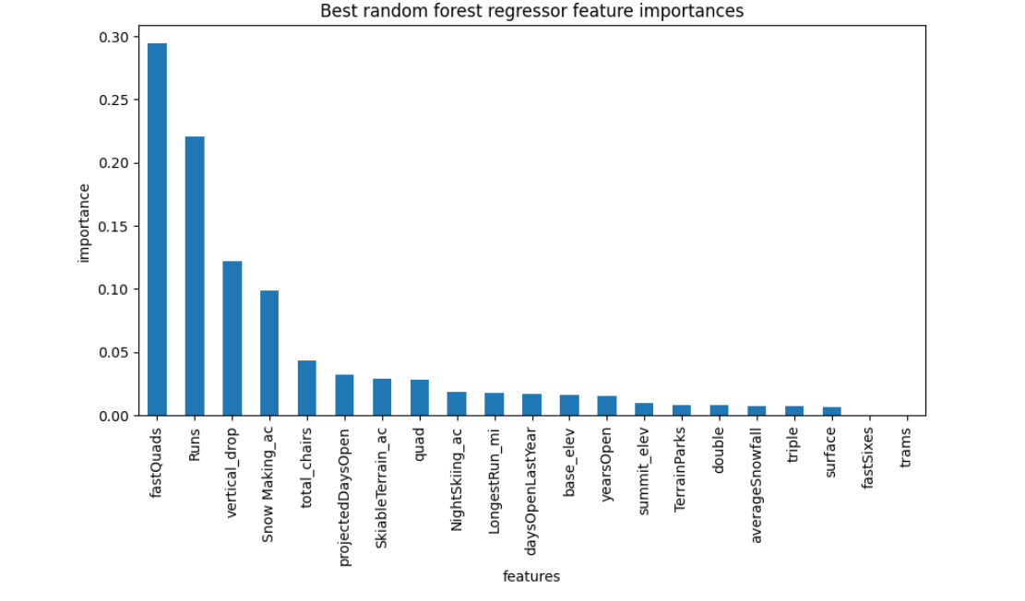
Modeling results and analysis
A linear regression model (model #1) and Random forest regression model (model #2) were evaluated & compared using metrics such as R-squared, Mean Absolute Error, and Mean Squared Error along with applying Cross-Validation. As expected, during preprocessing & algorithm testing, the best parameters in both models were nearly equivalent
vertical_drop
Snow Making_ac
total_chairs
fastQuads
Runs
LongestRun_mi
trams
SkiableTerrain_ac

Slide 6
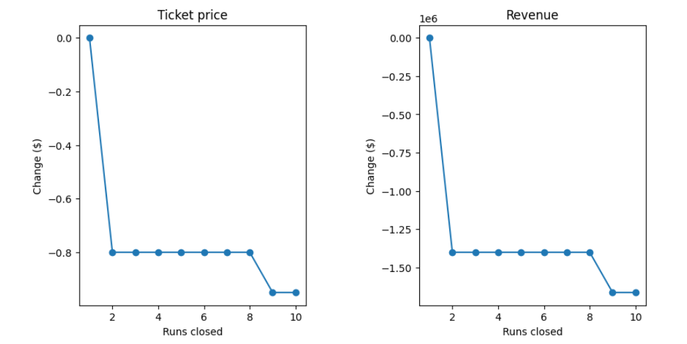
Modeling results and analysis
To better correlate how features/facilities support a given ticket price the models were tested for the following scenarios:
Scenario 1: Permanently closing down up to 10 of the least used runs.
Scenario 2: Increase the vertical drop by adding a run to a point 150 feet lower down but requiring the installation of an additional chair lift to bring skiers back up, without additional snow making coverage
Scenario 3: Same as number 2, but adding 2 acres of snow making cover
Scenario 4: Increase the longest run by 0.2 mile to boast 3.5 miles length, requiring an additional snow making coverage of 4 acres
Results for each of the scenarios were:
Scenario 1 – The model says closing one run makes no difference. Closing 2 and 3 successively reduces support for ticket price and so revenue. If Big Mountain closes down 3 runs, it seems they may as well close down 4 or 5 as there's no further loss in ticket price. Increasing the closures down to 6 or more leads to a large drop.

Slide 7
Modeling results and analysis
Scenario 2
This scenario increases support for ticket price by $3.00
Over the season, this could be expected to amount to $5250000
Scenario 3
This scenario increases support for ticket price by $3.00
Over the season, this could be expected to amount to $5250000
Scenario 3
No difference whatsoever. Although the longest run feature was used in the linear model, the random forest model (the one we chose because of its better performance) only has longest run way down in the feature importance list.

Slide 8
Summary and Conclusion
Currently Big Mountain charges $80.00 per Adult during weekends. The models run on the four key scenarios resulted us in drawing the conclusion based on two scenarios that if the ticket is increased by $3.00 will effectively generate revenue to support additional chair lift installation that increases their operating costs by $1,540,000.This proves to be a better value for their ticket price.

